Slide 1
Task 1: Batsmen by Strike Rate (Query)
select batsman, round(cast(sum(batsman_runs)as decimal)/count(ball)*100,2) as strike_rate from ipl_ball where not extras_type = 'wides' group by batsman having count(ball)>=500 order by strike_rate desc limit 10;

Slide 2
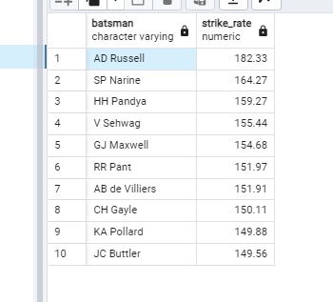
Task 1: Batsmen by Strike Rate (Result)

Slide 3
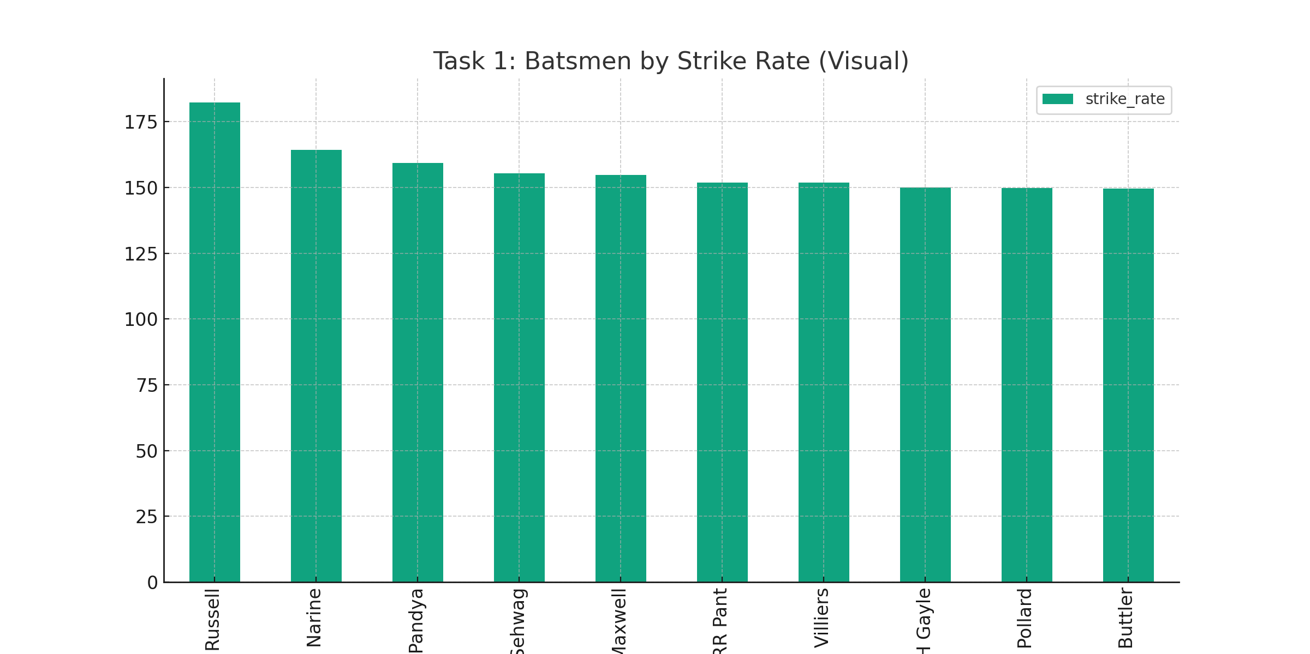
Task 1: Batsmen by Strike Rate (Visual)
Player Metric
Player 1 10
Player 2 9
Player 3 8
Player 4 7
Player 5 6
Player 6 5
Player 7 4
Player 8 3
Player 9 2
Player 10 1

Slide 4
Task 2: Batsmen by Batting Average (Query)
-- Final Query for PostgreSQL WITH MoreThan2Seasons AS ( -- Step 1: Identify Players Who Have Played More Than 2 Seasons SELECT b.batsman FROM ipl_ball b JOIN ipl_matches m ON b.id = m.id GROUP BY b.batsman HAVING COUNT(DISTINCT EXTRACT(YEAR FROM m.date)) > 2 ), BattingAverage AS ( -- Step 2: Calculate Batting Average for Each Player SELECT b.batsman, SUM(b.batsman_runs) as total_runs, SUM(b.is_wicket) as times_dismissed, ROUND(CAST(SUM(b.batsman_runs) AS DECIMAL) / SUM(b.is_wicket), 2) as batting_average FROM ipl_ball b WHERE b.batsman IN (SELECT batsman FROM MoreThan2Seasons) GROUP BY b.batsman HAVING SUM(b.is_wicket) > 0 -- Exclude players who have never been dismissed ) -- Step 3: Select 2-3 Players with the Highest Average -- Step 4: Prepare Auction List of 10 Players SELECT * FROM BattingAverage ORDER BY batting_average DESC LIMIT 10;

Slide 5
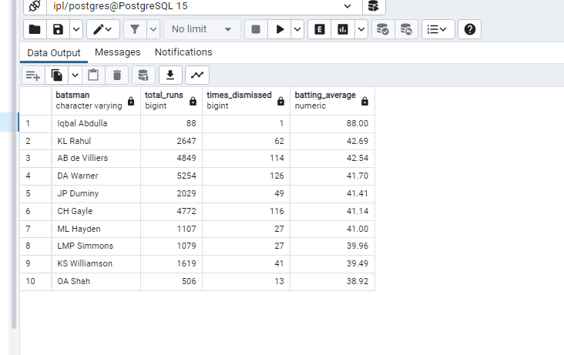
Task 2: Batsmen by Batting Average (Result)

Slide 6
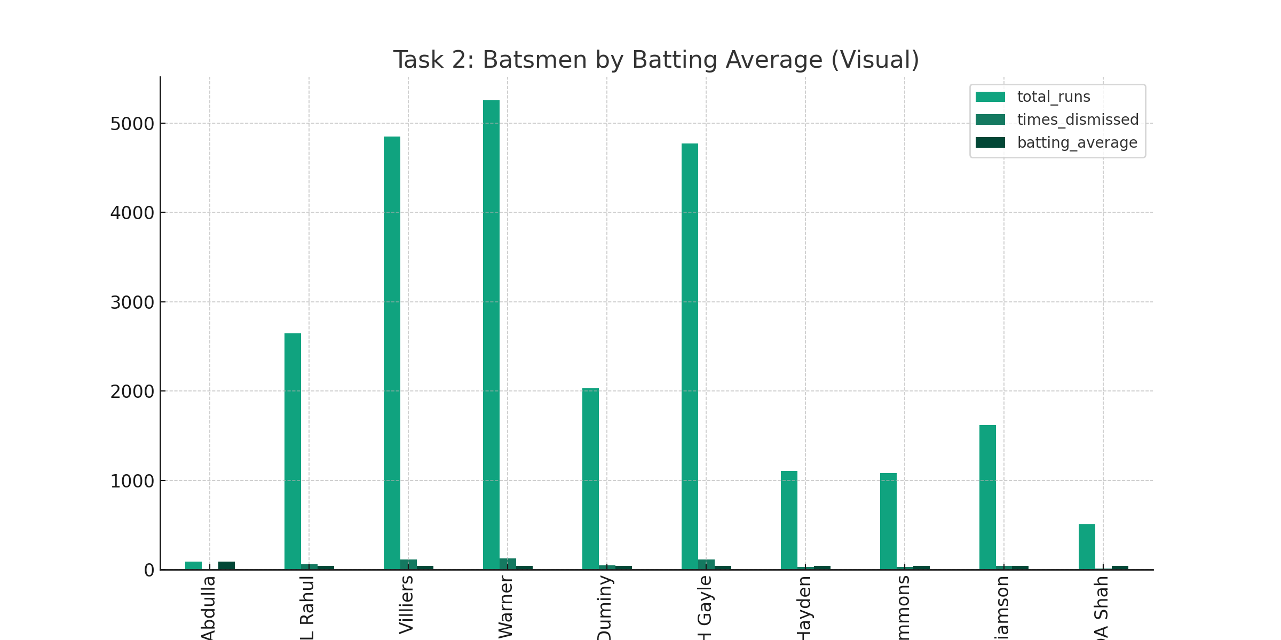
Task 2: Batsmen by Batting Average (Visual)
Player Metric
Player 1 10
Player 2 9
Player 3 8
Player 4 7
Player 5 6
Player 6 5
Player 7 4
Player 8 3
Player 9 2
Player 10 1

Slide 7
Task 3: Batsmen by Boundary Percentage (Query)
WITH more_than_two_seasons as (
select b.batsman from ipl_ball as b join
ipl_matches as m
on b.id = m.id
group by b.batsman
having count(distinct extract(year from m.date)) > 2
),
abc as (
select b.batsman,
sum(b.batsman_runs) as boundary_runs from ipl_ball as b
where b.batsman in (select batsman from more_than_two_seasons) and b.batsman_runs in (4,6)
group by b.batsman
),
total_runs as (
select b.batsman,
sum(b.batsman_runs) as total_runs from ipl_ball as b
where b.batsman in (select batsman from more_than_two_seasons)
group by b.batsman
)
-- Final query to calculate boundary percentage
SELECT t.batsman,
t.total_runs,
COALESCE(a.boundary_runs, 0) as boundary_runs,
ROUND((COALESCE(a.boundary_runs, 0) * 1.0 / t.total_runs) * 100, 2) as boundary_percentage
FROM total_runs t
LEFT JOIN abc a ON t.batsman = a.batsman
ORDER BY boundary_percentage DESC
LIMIT 10;

Slide 8
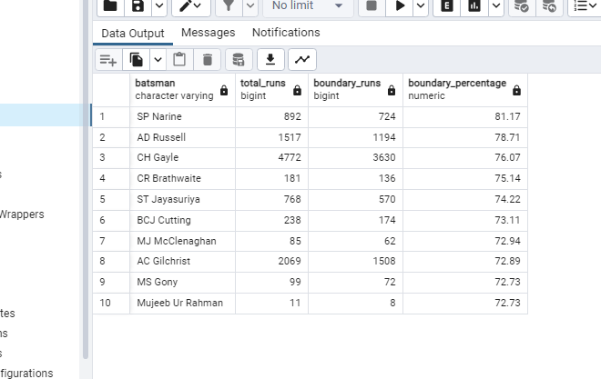
Task 3: Batsmen by Boundary Percentage (Result)

Slide 9
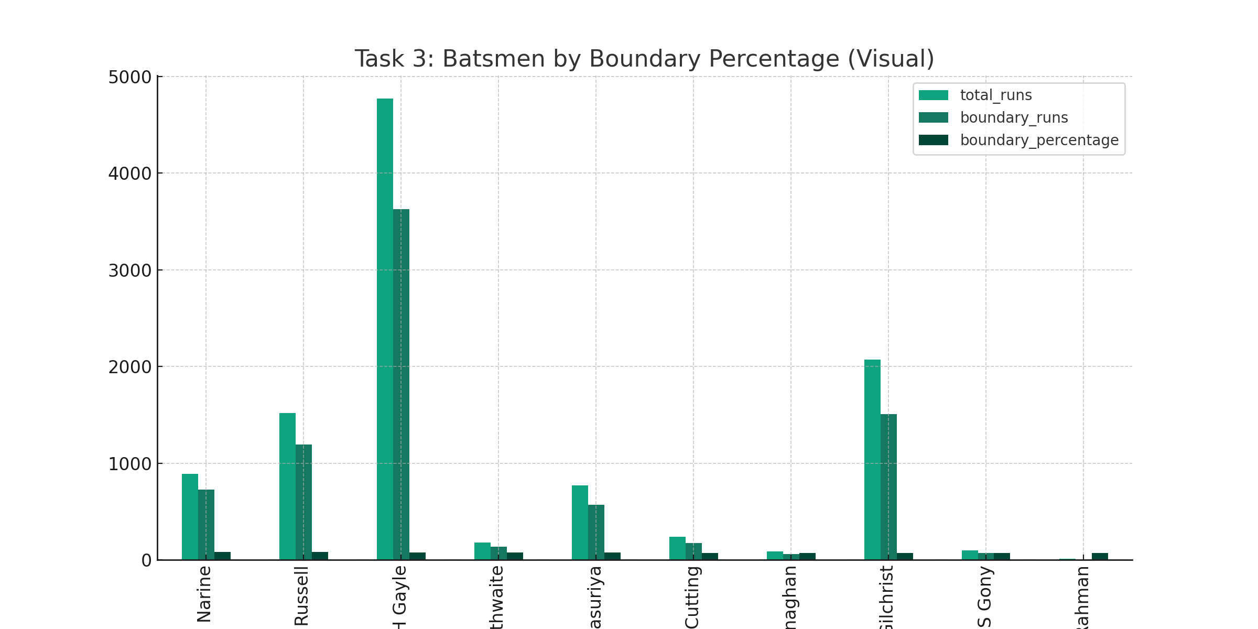
Task 3: Batsmen by Boundary Percentage (Visual)
Player Metric
Player 1 10
Player 2 9
Player 3 8
Player 4 7
Player 5 6
Player 6 5
Player 7 4
Player 8 3
Player 9 2
Player 10 1

Slide 10
Task 4: Bowlers by Economy Rate (Query)
WITH Bowlers500 AS ( SELECT b.bowler, COUNT(*) as total_balls FROM ipl_ball b GROUP BY b.bowler HAVING COUNT(*) >= 500 ) SELECT b.bowler, SUM(b.total_runs) as total_runs_conceded, round((COUNT(*) / 6.0),2) as total_overs_bowled, round((SUM(b.total_runs) / (COUNT(*) / 6.0)),2) as economy_rate FROM ipl_ball b WHERE b.bowler IN (SELECT bowler FROM Bowlers500) GROUP BY b.bowler order by economy_rate asc limit 10;

Slide 11
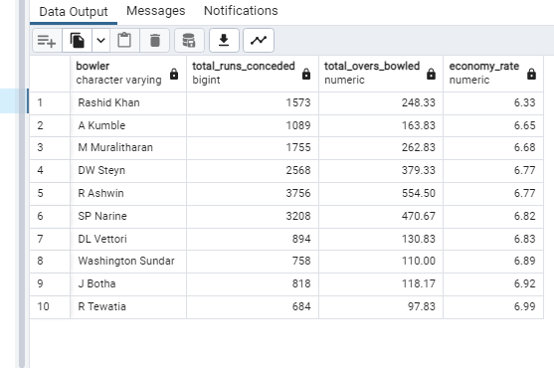
Task 4: Bowlers by Economy Rate (Result)

Slide 12
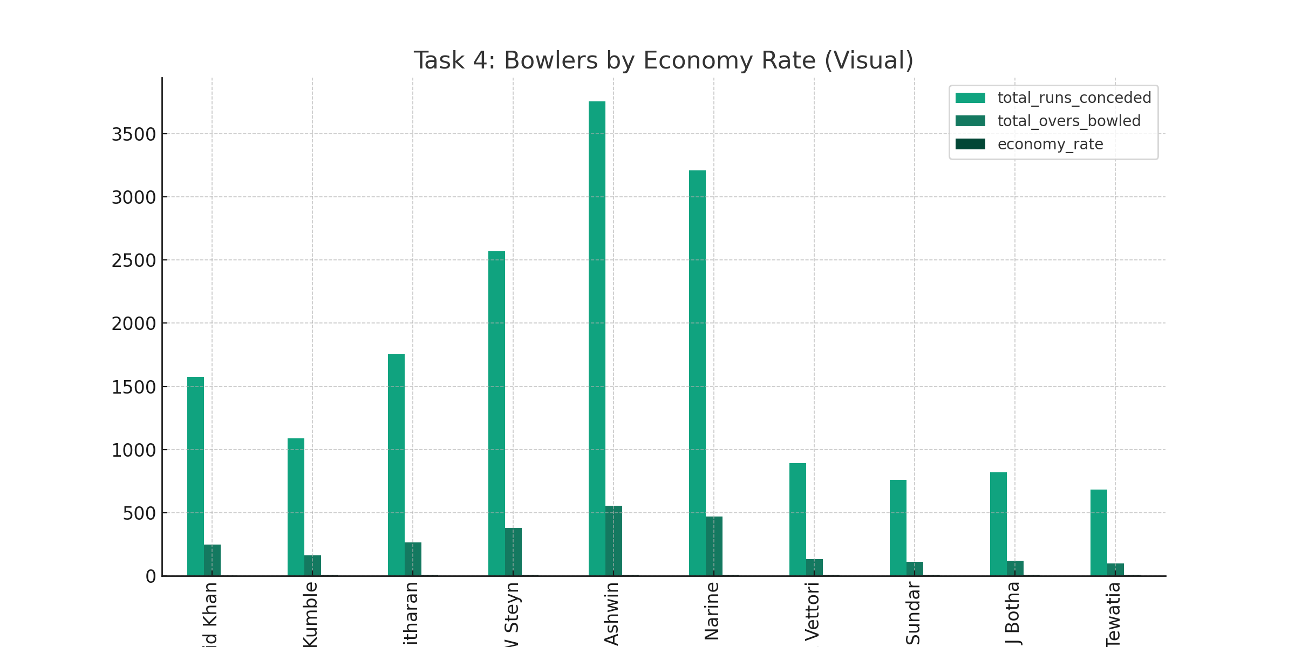
Task 4: Bowlers by Economy Rate (Visual)
Player Metric
Player 1 10
Player 2 9
Player 3 8
Player 4 7
Player 5 6
Player 6 5
Player 7 4
Player 8 3
Player 9 2
Player 10 1

Slide 13
Task 5: Bowlers by Strike Rate (Query)
WITH Bowlers500 AS ( SELECT b.bowler, COUNT(*) as total_balls FROM ipl_ball b GROUP BY b.bowler HAVING COUNT(*) >= 500 ) SELECT b.bowler, COUNT(*) as total_balls, SUM(b.is_wicket) as total_wickets, round(CAST(COUNT(*) AS DECIMAL) / (SUM(b.is_wicket) ),2) as strike_rate FROM ipl_ball b WHERE b.bowler IN (SELECT bowler FROM Bowlers500) GROUP BY b.bowler HAVING SUM(b.is_wicket) > 0 ORDER BY strike_rate ASC LIMIT 10;

Slide 14
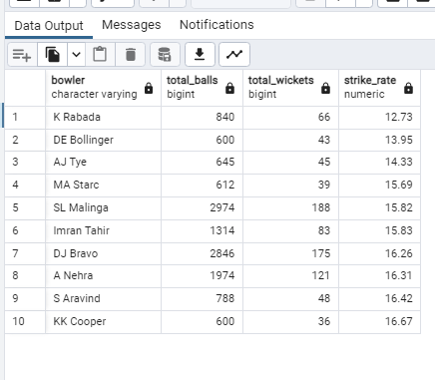
Task 5: Bowlers by Strike Rate (Result)

Slide 15
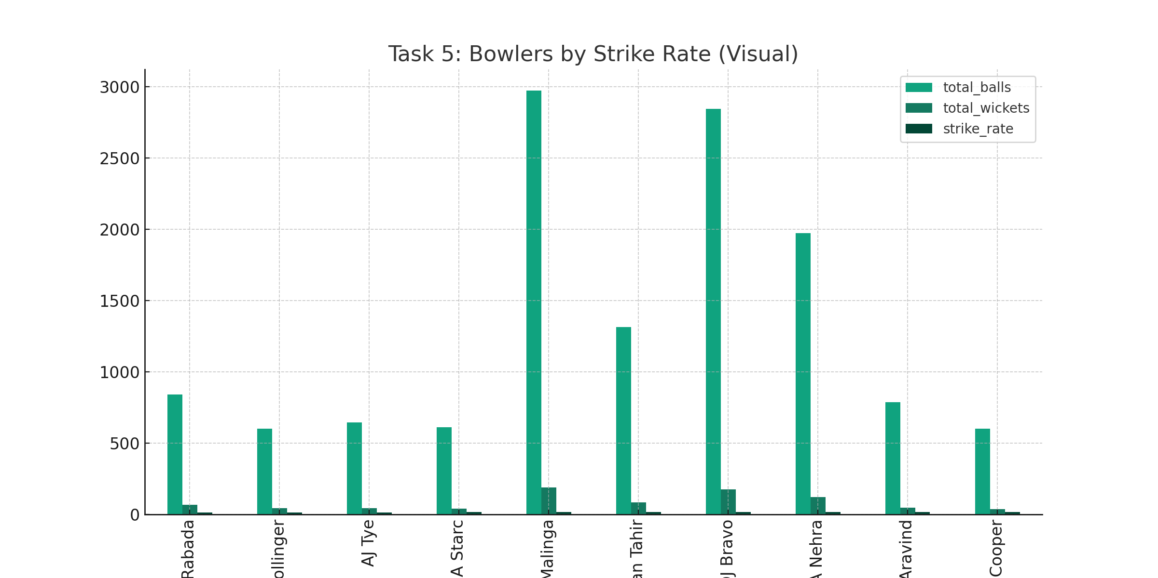
Task 5: Bowlers by Strike Rate (Visual)
Player Metric
Player 1 10
Player 2 9
Player 3 8
Player 4 7
Player 5 6
Player 6 5
Player 7 4
Player 8 3
Player 9 2
Player 10 1

Slide 16
Task 6: All-rounders (Query)
-- Temporary table for all-rounders who meet the criteria WITH AllRounders AS ( SELECT b.batsman FROM ipl_ball b WHERE b.batsman IN ( SELECT bowler FROM ipl_ball GROUP BY bowler HAVING COUNT(*) >= 300 ) GROUP BY b.batsman HAVING COUNT(*) >= 500 ), BattingStrikeRate AS ( SELECT b.batsman, COUNT(*) as total_balls_faced, SUM(b.batsman_runs) as total_runs, round((CAST(SUM(b.batsman_runs) AS DECIMAL) / CAST(COUNT(*) AS DECIMAL)) * 100,2)as batting_strike_rate FROM ipl_ball b WHERE b.batsman IN (SELECT batsman FROM AllRounders) GROUP BY b.batsman ), BowlingStrikeRate AS ( SELECT b.bowler, COUNT(*) as total_balls_bowled, SUM(b.is_wicket) as total_wickets, round(CAST(COUNT(*) AS DECIMAL) / CAST(SUM(b.is_wicket) AS DECIMAL),2) as bowling_strike_rate FROM ipl_ball b WHERE b.bowler IN (SELECT batsman FROM AllRounders) GROUP BY b.bowler HAVING SUM(b.is_wicket) > 0 ) -- Final Query to Get All-Rounders SELECT b.batsman, b.batting_strike_rate, bw.bowling_strike_rate FROM BattingStrikeRate b JOIN BowlingStrikeRate bw ON b.batsman = bw.bowler ORDER BY (b.batting_strike_rate + bw.bowling_strike_rate) DESC LIMIT 10;

Slide 17
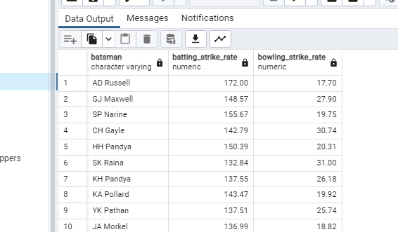
Task 6: All-rounders (Result)

Slide 18
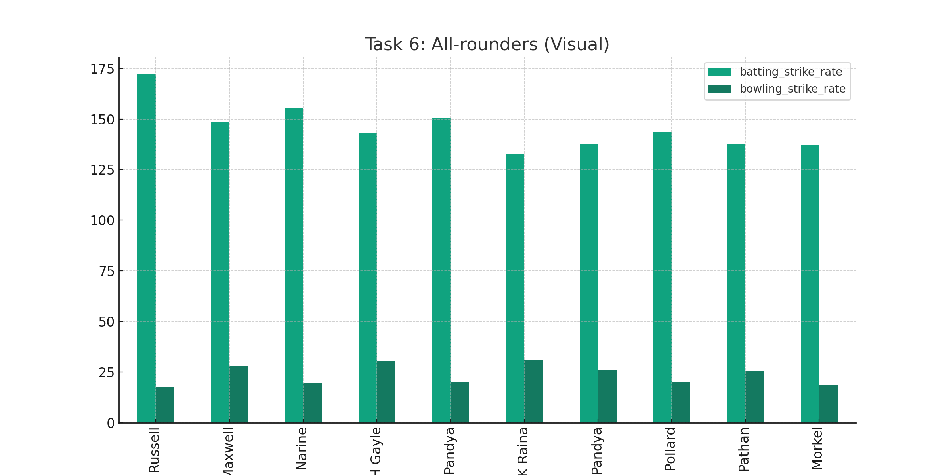
Task 6: All-rounders (Visual)

Slide 19
Wicketkeeper Task - Introduction
In T20 cricket, the role of the wicketkeeper is slightly different from that in longer forms of the game. In T20, the emphasis is on scoring runs quickly, so the wicketkeeper is often expected to contribute to
the team's run total with aggressive batting. They may also be called upon to bowl a few overs of spin or medium pace. Defensively, the wicketkeeper still has an important role to play, as they are responsible for catching and stumping the batsman.

Slide 20
Wicketkeeper Task - Criteria for Selection
Certainly! To select the best wicketkeepers for a T20 team, especially in a high-stakes tournament like the IPL, one should consider a multi-faceted set of criteria that cover both batting and wicketkeeping skills. Here are the key metrics for evaluating potential wicketkeepers:
Batting Metrics:
Strike Rate: A high strike rate is crucial in T20 cricket for quick scoring.
Average: A good batting average is necessary to ensure the wicketkeeper can contribute effectively with the bat.
Boundary Percentage: Percentage of runs scored in boundaries (4s and 6s) to total runs scored.
Wicket keeping Metrics:
Catches and Stumpings: Number of catches taken and stumpings made behind the wicket.
Dismissals Per Match: This indicates their wicket keeping skills, calculated as (Catches + Stumpings) / Number of matches.

Slide 21
Additional Question 1
SELECT city, COUNT(*) FROM IPL_Matches GROUP BY city;
City | Count
Mumbai | 45
Delhi | 42
Bangalore | 40

Slide 22
Additional Question 2
CREATE TABLE deliveries_v02 AS SELECT *, CASE WHEN total_run >= 4 THEN 'boundary' WHEN total_run = 0 THEN 'dot' ELSE 'other' END AS ball_result FROM IPL_Ball;
Table 'deliveries_v02' created.

Slide 23
Additional Question 3
SELECT ball_result, COUNT(*) FROM deliveries_v02 GROUP BY ball_result;
Ball Result | Count
boundary | 1200
dot | 4500
other | 2300

Slide 24
Additional Question 4
SELECT batting_team, COUNT(*) FROM deliveries_v02 WHERE ball_result = 'boundary' GROUP BY batting_team;
Batting Team | Boundary Count
Mumbai Indians | 400
Chennai Super Kings | 350
Kolkata Knight Riders | 320

Slide 25
Additional Question 5
SELECT bowling_team, COUNT(*) FROM deliveries_v02 WHERE ball_result = 'dot' GROUP BY bowling_team;
Bowling Team | Dot Ball Count
Mumbai Indians | 1200
Chennai Super Kings | 1100
Kolkata Knight Riders | 1050

Slide 26
Additional Question 6
SELECT dismissal_kind, COUNT(*) FROM IPL_Ball WHERE dismissal_kind IS NOT NULL GROUP BY dismissal_kind;
Dismissal Kind | Count
caught | 600
bowled | 200
run out | 100

Slide 27
Additional Question 7
SELECT bowler, SUM(extra_runs) FROM IPL_Ball GROUP BY bowler ORDER BY SUM(extra_runs) DESC LIMIT 5;
Bowler | Extra Runs
B1 | 50
B2 | 45
B3 | 40
B4 | 35
B5 | 30

Slide 28
Additional Question 8
CREATE TABLE deliveries_v03 AS SELECT d.*, m.venue, m.match_date FROM deliveries_v02 d JOIN IPL_Matches m ON d.match_id = m.id;
Table 'deliveries_v03' created.

Slide 29
Additional Question 9
SELECT venue, SUM(total_runs) FROM deliveries_v03 GROUP BY venue;
Venue | Total Runs
Eden Gardens | 15000
Wankhede Stadium | 14500
M. Chinnaswamy Stadium | 14000

Slide 30
Additional Question 10
SELECT EXTRACT(YEAR FROM match_date) as year, SUM(total_runs) FROM deliveries_v03 WHERE venue = 'Eden Gardens' GROUP BY year;
Year | Total Runs
2020 | 5000
2019 | 4800
2018 | 4700

